Slide 1
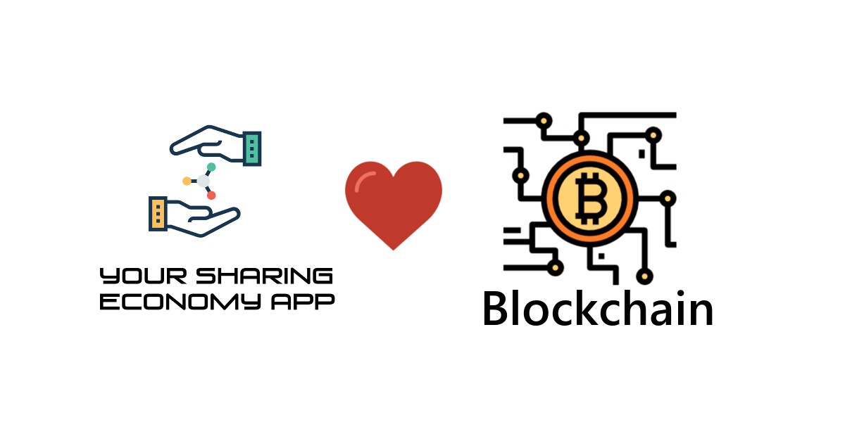
Case Study: Sharing Economy App + Blockchain

Slide 2
Presentation
Esteban Gallardo
Freelance Programmer
Specialized in VR/AR, networking apps
Expert in Unity, C#, Java, PHP and anything to make a project come true
Aspiring Entrepreneur :)
Email: esteban@yourvrexperience.com
Slack: https://yourvrexperience.slack.com
GitHub: https://github.com/EstebanGameDevelopment

Slide 3
3º Industrial Revolution
I will keep it short:
  The third industrial revolution is to understand that nowdays everything is connected in this world.
  Projects are becoming more and more complex, and they can't be done by single teams but by a network of teams working synchronized.
  The future workflow will be to get the most from the connections.
The best reference I can give you is this video. If you really want to participate in a better future you have to see it:
  https://www.youtube.com/watch?v=QX3M8Ka9vUA

Slide 4
Choose your own path
The first part of the presentation we are going to focus to understand the use of C# Nbitcoin DLL to perform multiple operations with the Blockchain technology.
After that we are going to see a real case project where we use this technology for a Sharing Economy App.
Both parts are independents from each other, so you can leave at anytime if you are not interested in the topic.

Slide 5
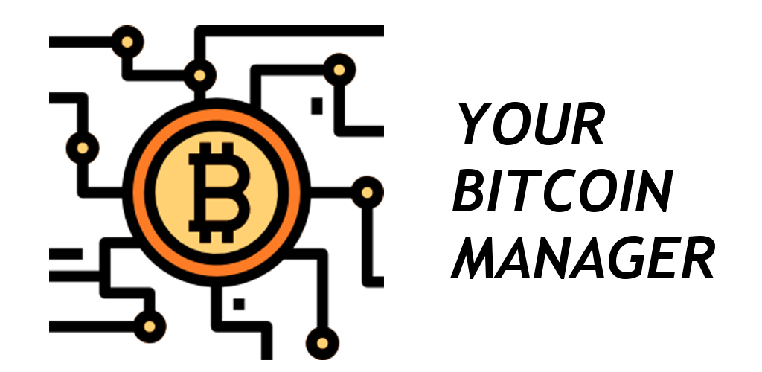
Code C# NBitcoin

Slide 6
BitcoinController
First we are going to run examples, then we are going to examine the code of that examples
Download the repo:
  https://github.com/EstebanGameDevelopment/YourBitcoinController
Create a new Unity project and paste the code in "Assets" folder

Slide 7
Bitcoin Controller
Example Manager
Run BasicManager.unity scene
  Explanation of Test Net and Main Net for Bitcoin
  Open Visual Studio: BasicManager.cs and show the private keys we are using
  Get Balance of all the accounts
  Get transaction summary of an account
  Perform a transaction

Slide 8
Bitcoin Controller
Example Create Keys
Run CreateKeys.unity scene:
  Create a new key
  Add funds:
    https://testnet.manu.backend.hamburg/faucet
  Replace the key in the BasicManager.cs
  Get balance of key

Slide 9
Bitcoin Controller
Example SignData
Run the SignTextData.unity scene:
  Sign a text data
  Verify the text data
Run the SignImageData.unity scene:
  Sign an image hash
  Verify an image hash

Slide 10
Code C# BitcoinController
Wallet Information
Let's check how we are getting the balance of an Bitcoin Wallet.
  BitcoinController.cs
    decimal GetBalance(string _privateKey, bool _dispatchEvent = false)
We are going to examine of we get all the information about all the transactions done on an wallet key address
  BitcoinController.cs
    void GetAllInformation(string _publicKeyAdress)

Slide 11
Code C# BitcoinController.cs
Execute Transaction
Let's take a look to the c# code used to make a payment.
  BitcoinController.cs
    ExecuteTransaction(string _title, decimal _finalFeeAmount, params PaymentModel[] _payments)
      var customerPrivateKey = new BitcoinSecret(m_currentPrivateKey);
      GetUnspentCoins(customerPrivateKey.GetAddress(), false);
      GetTransactionInputCoins(customerPrivateKey.GetAddress(), coinsInCustomerWallet, totalAmountToPay);
      Transaction customerTransaction = new Transaction();
      AddInputs(customerTransaction, customerPrivateKey, coinsToSpendInVideo, totalAmountToPay);
      AddOutputs(customerTransaction, customerPrivateKey, _finalFeeAmount, _payments, totalAmountToPay, coinsToSpendInVideo);
      AddOutputMessage(customerTransaction, _title);
      SignTransaction(customerTransaction, customerPrivateKey);
      BroadcastTransaction(clientQBitNinja, customerTransaction);

Slide 12
Code C# BitcoinController.cs
Signature Data
Let's see how we can use our keys to sign the data for authentication purposes
  string SignTextData(string _data, string _currentPrivateKey)
  bool VerifySignedData(string _dataOriginal, string _dataSigned, string _publicKey)

Slide 13
Code C# Nbitcoin
Exchange Information:
  EVENT_BITCOINCONTROLLER_JSON_EXCHANGE_TABLE
    https://blockchain.info/ticker
Fee Information:
  EVENT_BITCOINCONTROLLER_JSON_FEE_TABLE
    https://bitcoinfees.earn.com/api/v1/fees/recommended

Slide 14
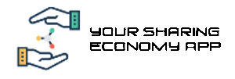
Create your own
Sharing Economy Application

Slide 15
1. Download
Unity SDK
Import the package YourSharingEconomyApp from Unity Asset Store
Switch Scripting Runtime Version to:
  .NET 4.x Equivalent
Import the packages:
    Facebook SDK package
    Unity IAP
    Flatcalendar package

Slide 16
2. XAMPP
XAMPP install
  https://www.apachefriends.org/download.html
Change port to avoid collision (usually Skype)
    [XAMPP Installation Folder]/apache/conf/httpd.conf.
    Listen 8080

Slide 17
3. Create Database
Open PHPMyAdmin:
  http://localhost:8080/phpmyadmin
Create a database called "yoursharingeconomyapp" (you can call it later like you want but let's keep it this way in this tutorial)
Import database from
    Assets/YourSharingEconomyApp/SERVER/DATABASE

Slide 18
4. PHP
Copy PHP into the folder:
  SOURCE:
    Assets/YourSharingEconomyApp/SERVER/PHP
TO:
    c:/xampp/htdocs/yoursharingeconomyapp

Slide 19
5. Basic Server Configuration
Open configuration file and set up DATABASE and constants:
c:/xampp/htdocs/yoursharingeconomyapp/
    ConfigurationYourSharingEconomyApp.php
      LOCAL SERVER CONNECTION
      DATABASE CONNECTION
      URL SERVICES

Slide 20
6. Basic Configuration Client
Open ScreenController.cs and set the constant:
public const string URL_BASE_PHP = "http://localhost:8080/yoursharingeconomyapp/";

Slide 21
7. Run the App and Register by Email
Run the application and register a new user.
PLEASE, USE A PASSWORD YOU CAN REMEMBER, THIS IS FOR TESTING SO, "123" IS OK :)
For the example there is not a email verification process to ease this tutorial. If you want to enable the email verification process just check the file ConfigurationYourSharingEconomyApp.php and set variable:
  $ENABLE_EMAIL_SERVER = 1

Slide 22
8. Create multiple accounts
We are going to create another accounts. First, go here to clear local data:
"Tools->Your Sharing Economy Tools->Clear PlayerPrefs"
Repeat the process to create the another account so we will have two accounts. One will be the provider of services, the other will be the customer

Slide 23
9. Account Switcher
Open file YourSharingEconomyAppTools.cs.
In this file we are going to write down the email/password we have used before.
This tool will allow to switch between account fast to be able to develop without problems.
Let's do a fast test switching between the profiles we have previously created.

Slide 24
10. Create a request for service
Next, one of our accounts is going to be a customer looking for a service.
Now we are going to create a request.

Slide 25
11. Provider makes a proposal
Next, we are going to take the rol of the provider of services and make a proposal for the previous job created.
First, we go to the profile section, we activate that we are a provider of services and we can fill our profile.
Next, we will search for work and make a proposal

Slide 26
12. Client accepts the proposals
We go back to the client and accept the proposal of the provider

Slide 27
13. Provider finishs job
It's up to the provider to finish the job, so we switch to his profile and we post an image with the results

Slide 28
14. Blockchain
Time for the Blockchain
We will create a Bitcoin wallet which we will use for 2 things:
  First, make a payment using Bitcoins
  Second, using the power of the Blockchain to verify the authenticity of the job performed and that the two parts had agreed to the description of that job.
We are going to use TestNet in order to use the tools that the Blockchain offers without the need to spend real money.

Slide 29
15. Provider Sets Up Blockchain Address
Before proceeding to the payment, we have to set up the Bitcoin Key Address of the provider in order to be able to execute the payment and be able to use the our signature on the data.
In the section Profile we can create a new key.
REMEMBER TO PRESS SEND EMAIL TO SAVE YOUR PRIVATE KEY ADDRESS.

Slide 30
16. Client Validation By Payment
It's time for the customer to pay and verify that the picture belongs to the work done.
We will press the button Payment.
Since we didn't have set up a Blockchain Key Address we set up one now and we add funds.
REMEMBER TO PRESS SEND EMAIL TO SAVE YOUR PRIVATE KEY ADDRESS.
We proceed with the payment.

Slide 31
17. Client Scores Provider
After the payment is completed the customer will have the option to score the provider.
By scoring the work of the provider we acknowledge that the work relationship between provider and customer has been completed.
This data is going to be signed with the Blockchain address we previouly created and that will prove that the customer has agreed with the current request completed and his feedback.

Slide 32
18. Provider Scores Customer
Back to the service provider he is also able to provide some feedback about the customer to balance the things.
Again the data is going to be signed so that way we agreed with the final conclusion of the job done.

Slide 33
19. Signed Deal
We have used the Blockchain keys we previously generated to sign the data as a proof of authenticity.
Thanks to the Blockchain we can sign any data with our address to prove that data belong to us.

Slide 34
20. Scores for both
Now the score of both client and service provider has been added to their respective global scores.
This scores are in the profiles of both the provider and the customer so the other customer and provider can get a reference of these persons.

Slide 35

Create your Custom solution

Slide 36
Custom Texts
The whole thing is prepared in order to be able to make few changes and customize your own solution.
First, let's see the file with all the texts. We keep it simple:
    we just chage the title
    Replace the word "Provider" by your own professional
Now, let's do some customization of critical images. Copy and paste these images.
  _CUSTOMIZE\*.*
  Assets\YourSharingEconomyApp\CLIENT\Resources\images

Slide 37
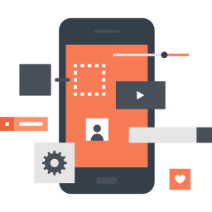

And... It's done!!
....
You have your own sharing economy app!!!

Slide 38
You have a MVP
...Well, of course, it's not finished, but at least you know that you have a template that it's easy to customize
Thanks to this template you can develop a MVP (Minimal Viable Product) at a really low cost
You are free to use it and it can help to any community or providers of services who want to create a wider network of connections

